Slide 1

Apple, Inc. 1984 Television Commercial False Individual Freedom in America Business World
Author: 方盛俊

Slide 2
FREEDOM IN AMERICA

Slide 3
FREEDOM IN AMERIC

Slide 4
FREEDOM IN AMERI

Slide 5
FREEDOM IN AMER

Slide 6
FREEDOM IN AME

Slide 7
FREEDOM IN AM

Slide 8
FREEDOM IN A

Slide 9
FREEDOM IN AP

Slide 10
FREEDOM IN APP

Slide 11
FREEDOM IN APPL

Slide 12
FREEDOM IN APPLE

Slide 13
FREEDOM IN APPLE
?
1984 Commercial in 1984

Slide 14
FREEDOM IN APPLE
?
1984 Commercial in 1984

Slide 15
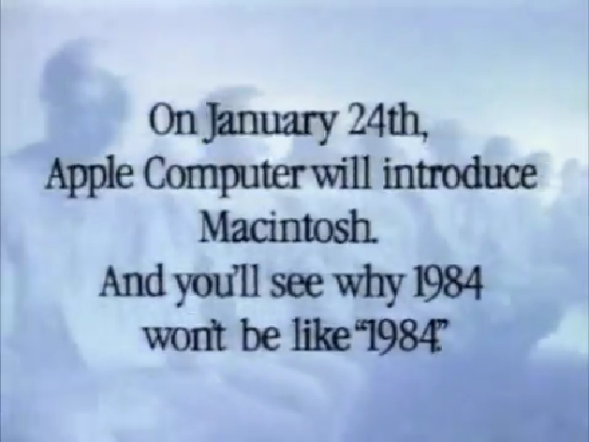
1984 Commercial in 1984

Slide 16
SYMBOL OF FREEDOM ?
The Highest Market Value

Slide 17
SYMBOL OF FREEDOM ?
The Highest Market Value

Slide 18
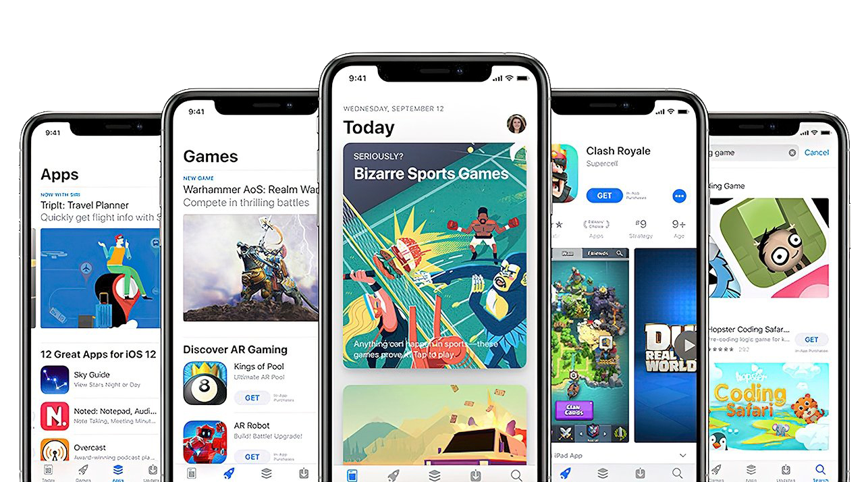
App Store
30%
Apple Tax

Slide 19
App Store
30%
Apple Tax
PROFIT
INCOME

Slide 20

Vs.
Apple
Epic

Slide 21
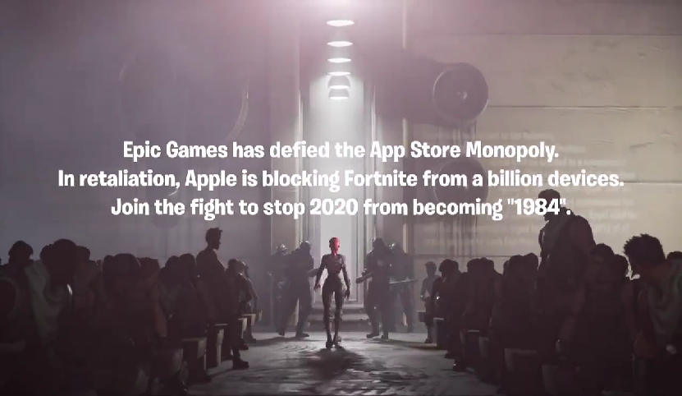
Epic
Vs.
Apple

Slide 22
Individual freedom is NOT always true in America, At least in America business world.

